Slide 1

Turban, Aronson, and Liang Decision Support Systems and Intelligent Systems, Seventh Edition
© 2005 Prentice Hall, Decision Support Systems and Intelligent Systems, 7th Edition, Turban, Aronson, and Liang
10-<number>

Slide 2
Learning Objectives
Describe the basic concepts in artificial intelligence.
Understand the importance of knowledge in decision support.
Examine the concepts of rule-based expert systems.
Learn the architecture of rule-based expert systems.
Understand the benefits and limitations of rule based systems for decision support.
Identify proper applications of expert systems.
© 2005 Prentice Hall, Decision Support Systems and Intelligent Systems, 7th Edition, Turban, Aronson, and Liang
10-<number>

Slide 3
Intelligent Systems in KPN Telecom and Logitech Vignette
Problems in maintaining computers with varying hardware and software configurations
Rule-based system developed
  Captures, manages, automates installation and maintenance
    Knowledge-based core
    User-friendly interface
    Knowledge management module employs natural language processing unit
© 2005 Prentice Hall, Decision Support Systems and Intelligent Systems, 7th Edition, Turban, Aronson, and Liang
10-<number>

Slide 4
Artificial Intelligence
Duplication of human thought process by machine
  Learning from experience
  Interpreting ambiguities
  Rapid response to varying situations
  Applying reasoning to problem-solving
  Manipulating environment by applying knowledge
  Thinking and reasoning
© 2005 Prentice Hall, Decision Support Systems and Intelligent Systems, 7th Edition, Turban, Aronson, and Liang
10-<number>

Slide 5
Artificial Intelligence Characteristics
Symbolic processing
  Computers process numerically, people think symbolically
  Computers follow algorithms
    Step by step
  Humans are heuristic
    Rule of thumb
    Gut feelings
    Intuitive
Heuristics
  Symbols combined with rule of thumb processing
Inference
  Applies heuristics to infer from facts
Machine learning
  Mechanical learning
  Inductive learning
  Artificial neural networks
  Genetic algorithms
© 2005 Prentice Hall, Decision Support Systems and Intelligent Systems, 7th Edition, Turban, Aronson, and Liang
10-<number>

Slide 6
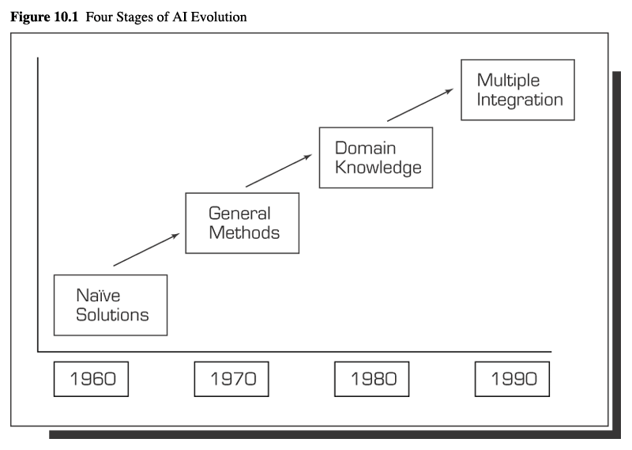
Development of Artificial Intelligence
Primitive solutions
Development of general purpose methods
Applications targeted at specific domain
  Expert systems
Advanced problem-solving
  Integration of multiple techniques
  Multiple domains
© 2005 Prentice Hall, Decision Support Systems and Intelligent Systems, 7th Edition, Turban, Aronson, and Liang
10-<number>

Slide 7
Artificial Intelligence Concepts
Expert systems
  Human knowledge stored on machine for use in problem-solving
Natural language processing
  Allows user to use native language instead of English
Speech recognition
  Computer understanding spoken language
Sensory systems
  Vision, tactile, and signal processing systems
Robotics
  Sensory systems combine with programmable electromechanical device to perform manual labor
© 2005 Prentice Hall, Decision Support Systems and Intelligent Systems, 7th Edition, Turban, Aronson, and Liang
10-<number>

Slide 8
Artificial Intelligence Concepts
Vision and scene recognition
  Computer intelligence applied to digital information from machine
Neural computing
  Mathematical models simulating functional human brain
Intelligent computer-aided instruction
  Machines used to tutor humans
    Intelligent tutoring systems
Game playing
  Investigation of new strategies combined with heuristics
© 2005 Prentice Hall, Decision Support Systems and Intelligent Systems, 7th Edition, Turban, Aronson, and Liang
10-<number>

Slide 9
Artificial Intelligence Concepts
Language translation
  Programs that translate sentences from one language to another without human interaction
Fuzzy logic
  Extends logic from Boolean true/false to allow for partial truths
  Imprecise reasoning
  Inexact knowledge
Genetic algorithms
  Computers simulate natural evolution to identify patterns in sets of data
Intelligent agents
  Computer programs that automatically conduct tasks
© 2005 Prentice Hall, Decision Support Systems and Intelligent Systems, 7th Edition, Turban, Aronson, and Liang
10-<number>

Slide 10
Experts
Experts
  Have special knowledge, judgment, and experience
  Can apply these to solve problems
    Higher performance level than average person
    Relative
    Faster solutions
    Recognize patterns
Expertise
  Task specific knowledge of experts
    Acquired from reading, training, practice
© 2005 Prentice Hall, Decision Support Systems and Intelligent Systems, 7th Edition, Turban, Aronson, and Liang
10-<number>

Slide 11
Expert Systems Features
Expertise
  Capable of making expert level decisions
Symbolic reasoning
  Knowledge represented symbolically
  Reasoning mechanism symbolic
Deep knowledge
  Knowledge base contains complex knowledge
Self-knowledge
  Able to examine own reasoning
  Explain why conclusion reached
© 2005 Prentice Hall, Decision Support Systems and Intelligent Systems, 7th Edition, Turban, Aronson, and Liang
10-<number>

Slide 12
Applications of Expert Systems
DENDRAL project
  Applied knowledge or rule-based reasoning commands
  Deduced likely molecular structure of compounds
MYCIN
  Rule-based system for diagnosing bacterial infections
XCON
  Rule-based system to determine optimal systems configuration
Credit analysis
  Ruled-based systems for commercial lenders
Pension fund adviser
  Knowledge-based system analyzing impact of regulation and conformance requirements on fund status
© 2005 Prentice Hall, Decision Support Systems and Intelligent Systems, 7th Edition, Turban, Aronson, and Liang
10-<number>

Slide 13
Applications
Finance
  Insurance evaluation, credit analysis, tax planning, financial planning and reporting, performance evaluation
Data processing
  Systems planning, equipment maintenance, vendor evaluation, network management
Marketing
  Customer-relationship management, market analysis, product planning
Human resources
  HR planning, performance evaluation, scheduling, pension management, legal advising
Manufacturing
  Production planning, quality management, product design, plant site selection, equipment maintenance and repair
© 2005 Prentice Hall, Decision Support Systems and Intelligent Systems, 7th Edition, Turban, Aronson, and Liang
10-<number>

Slide 14
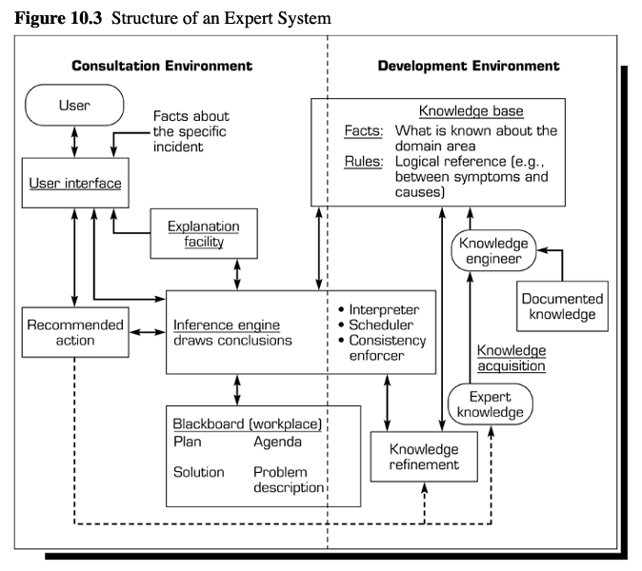
Environments
Consultation (runtime)
Development
© 2005 Prentice Hall, Decision Support Systems and Intelligent Systems, 7th Edition, Turban, Aronson, and Liang
10-<number>

Slide 15
Major Components of Expert Systems
Major components
  Knowledge base
    Facts
    Special heuristics to direct use of knowledge
  Inference engine
    Brain
    Control structure
    Rule interpreter
  User interface
    Language processor
© 2005 Prentice Hall, Decision Support Systems and Intelligent Systems, 7th Edition, Turban, Aronson, and Liang
10-<number>

Slide 16
Additional Components of Expert Systems
Additional components
  Knowledge acquisition subsystem
    Accumulates, transfers, and transforms expertise to computer
  Workplace
    Blackboard
    Area of working memory
    Decisions
      Plan, agenda, solution
  Justifier
    Explanation subsystem
      Traces responsibility for conclusions
  Knowledge refinement system
    Analyzes knowledge and use for learning and improvements
© 2005 Prentice Hall, Decision Support Systems and Intelligent Systems, 7th Edition, Turban, Aronson, and Liang
10-<number>

Slide 17
Knowledge Presentation
Production rules
  IF-THEN rules combine with conditions to produce conclusions
  Easy to understand
  New rules easily added
  Uncertainty
Semantic networks
Logic statements
© 2005 Prentice Hall, Decision Support Systems and Intelligent Systems, 7th Edition, Turban, Aronson, and Liang
10-<number>

Slide 18
Inference Engine
Forward chaining
  Looks for the IF part of rule first
  Selects path based upon meeting all of the IF requirements
Backward chaining
  Starts from conclusion and hypothesizes that it is true
  Identifies IF conditions and tests their veracity
  If they are all true, it accepts conclusion
  If they fail, then discards conclusion
© 2005 Prentice Hall, Decision Support Systems and Intelligent Systems, 7th Edition, Turban, Aronson, and Liang
10-<number>

Slide 19
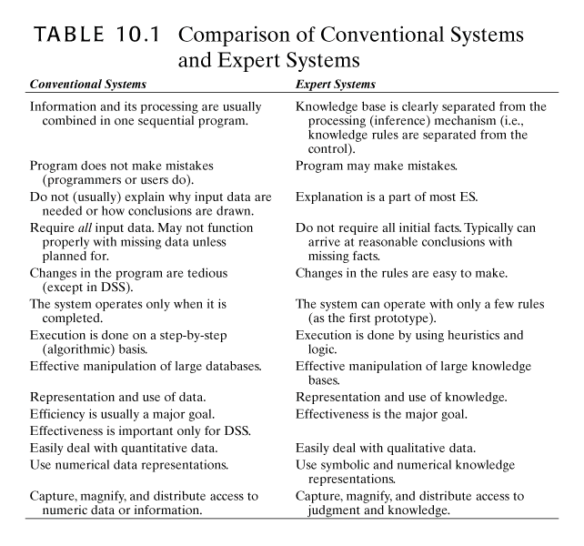
© 2005 Prentice Hall, Decision Support Systems and Intelligent Systems, 7th Edition, Turban, Aronson, and Liang
10-<number>

Slide 20
General Problems Suitable for Expert Systems
Interpretation systems
  Surveillance, image analysis, signal interpretation
Prediction systems
  Weather forecasting, traffic predictions, demographics
Diagnostic systems
  Medical, mechanical, electronic, software diagnosis
Design systems
  Circuit layouts, building design, plant layout
Planning systems
  Project management, routing, communications, financial plans
© 2005 Prentice Hall, Decision Support Systems and Intelligent Systems, 7th Edition, Turban, Aronson, and Liang
10-<number>

Slide 21
General Problems Suitable for Expert Systems
Monitoring systems
  Air traffic control, fiscal management tasks
Debugging systems
  Mechanical and software
Repair systems
  Incorporate debugging, planning, and execution capabilities
Instruction systems
  Identify weaknesses in knowledge and appropriate remedies
Control systems
  Life support, artificial environment
© 2005 Prentice Hall, Decision Support Systems and Intelligent Systems, 7th Edition, Turban, Aronson, and Liang
10-<number>

Slide 22
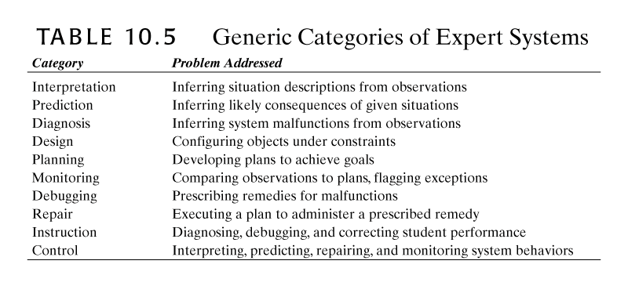
© 2005 Prentice Hall, Decision Support Systems and Intelligent Systems, 7th Edition, Turban, Aronson, and Liang
10-<number>

Slide 23
Benefits of Expert Systems
Increased outputs
Increased productivity
Decreased decision-making time
Increased process and product quality
Reduced downtime
Capture of scarce expertise
Flexibility
Ease of complex equipment operation
Elimination of expensive monitoring equipment
Operation in hazardous environments
Access to knowledge and help desks
© 2005 Prentice Hall, Decision Support Systems and Intelligent Systems, 7th Edition, Turban, Aronson, and Liang
10-<number>

Slide 24
Benefits of Expert Systems
Ability to work with incomplete, imprecise, uncertain data
Provides training
Enhanced problem solving and decision-making
Rapid feedback
Facilitate communications
Reliable decision quality
Ability to solve complex problems
Ease of knowledge transfer to remote locations
Provides intelligent capabilities to other information systems
© 2005 Prentice Hall, Decision Support Systems and Intelligent Systems, 7th Edition, Turban, Aronson, and Liang
10-<number>

Slide 25
Limitations
Knowledge not always readily available
Difficult to extract expertise from humans
  Approaches vary
  Natural cognitive limitations
  Vocabulary limited
  Wrong recommendations
Lack of end-user trust
Knowledge subject to biases
Systems may not be able to arrive at conclusions
© 2005 Prentice Hall, Decision Support Systems and Intelligent Systems, 7th Edition, Turban, Aronson, and Liang
10-<number>

Slide 26
Success Factors
Management champion
User involvement
Training
Expertise from cooperative experts
Qualitative, not quantitative, problem
User-friendly interface
Expert’s level of knowledge must be high
© 2005 Prentice Hall, Decision Support Systems and Intelligent Systems, 7th Edition, Turban, Aronson, and Liang
10-<number>

Slide 27
Types of Expert Systems
Rule-based Systems
  Knowledge represented by series of rules
Frame-based Systems
  Knowledge represented by frames
Hybrid Systems
  Several approaches are combined, usually rules and frames
Model-based Systems
  Models simulate structure and functions of systems
Off-the-shelf Systems
  Ready made packages for general use
Custom-made Systems
  Meet specific need
Real-time Systems
  Strict limits set on system response times
© 2005 Prentice Hall, Decision Support Systems and Intelligent Systems, 7th Edition, Turban, Aronson, and Liang
10-<number>

